Slide 1
Northwest Association of Umpires
2022 Spring Meeting
Respecting the Game since 1921

Slide 2
Dan Feigum
Summer Assignor
Contact information is cell phone 612-802-5661 email dfeigum@charter.net
Please keep your calendars up to date
accept games ASAP
if you text me please include your name
check in with partner and team contacts
Summer Tournaments i have entered so far
Gopher Classic July 8-12th
Shakopee Indians Amateur June 24th-26th 2-man 9 inning all games
Jordan Amateur July 8th-10th 1 man 7 innings
Legion Sub-State Burnsville July 29th-31st
River Valley League Tournament July 29th-31st
Respecting the Game since 1921
Notes:
2

Slide 3
Zach Gustafson
College+HS Assignor
Contact information: gussy97@msn.com Cell 763.516.3276
- Keep your schedule up to date in Arbiter, if you work for multiple assignors please ‘share’ your calendar with NWUA in Arbiter
Check in with your partner and the school 48 hours in advance of your games
Conferences/schools we cover: Metro West, Metro East, South Suburban Conference, Suburban East Conference, Minneapolis City Conference, ½ Northwest Suburban, ½ St. Paul City Conference, Minnehaha Academy, Red Wing, Northfield, Faribault, Richfield, Eagle Ridge Academy
Sections we cover: 1AAA, 1AAAA, 2AAAA, 3AAA, 3AAAA, 4AAA, 4AAAA, 6AAAA
Rates: Metro rate $83 NF, RW, Faribault - $88 Metro Contract year 3 of 5
Self assign for JV and B games
Scrimmages - St. Thomas Academy and Elk River - paid/observations Dates: 4/2, 4/4, 4/6, and 4/9
HS games start April 5th - First full week of games April 11th
Assigning process: Dues paid = games assignments starting this coming week through April, waiting on May pending weather No dues = no games
Schedules: Still do not have all schedules US Bank fully assigned (at this time)
Section 3.3.1 Bench and Field Conduct - verbal warning, written warning, ejection
Incident Reports - emailed to me within 24 hours
Are you getting the type of schedule you want? What are your goals as an umpire?
What makes a good umpire? Rule knowledge, judgement, demeanor, work ethic, communication skills, administrative duties
Why do you umpire? Money, give back to the game and kids/players, to be a part of the game you love
Respecting the Game since 1921
Notes:
3

Slide 4
Chad Eischens
President & CEO
Respecting the Game since 1921
Notes:
4

Slide 5
John Priester
Vice President
College:
*Cage Opportunities/Fall Ball
*US Bank Ball (two HS dates)
*College Umpiring
High School:
*Meeting/Exam (March 14th - March 30th)
*MSHSL clinic every 2 years
*No COVID protocols expected, social distancing at plate meeting, coaches only come to base lines
*Work through coaches (ex:pitcher wearing something illegal)
*Track all conferences, lineup changes, etc.
*Incident reports - sportsmanship
Respecting the Game since 1921
Notes:
5

Slide 6
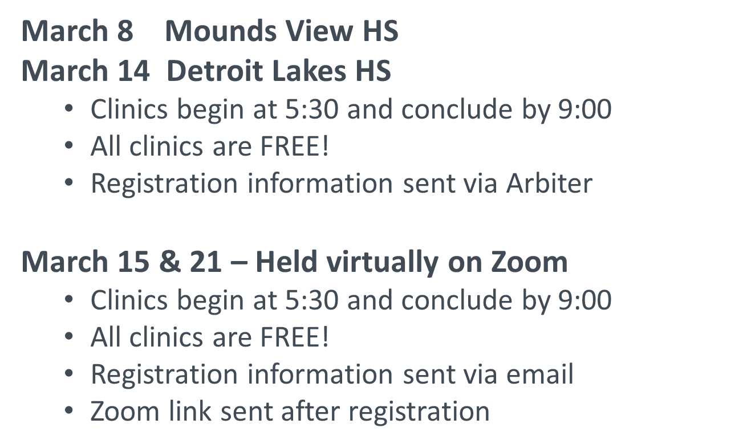
John Priester
Vice President
Respecting the Game since 1921
Notes:
6

Slide 7
Adam Berg
Mentorship
Rework of mentor program
Smaller groups, more individualized engagement with mentor/mentee
Regional approach
Assigning approach
Larry’s Role
3 years and Under
General Membership
College Group
Respecting the Game since 1921
Notes:
7

Slide 8
Russ Lundquist
Training
Expect video during the season. Send video if you have any
Scrimmages will have observers as schedules permit.
Ump-App
We will schedule a zoom meeting to learn about the app and its staff.
Respecting the Game since 1921
Notes:
8

Slide 9
Derek Roberts
Amateur
2022 Amateur Umpire Fees
2 man- 9 innings $105
1 man- 9 innings $140
2 man- 7 innings $95
1 man- 7 innings $110
2022 MBA Ejection Policy
2 games for any ejected player. No appeals. Ejection reports go directly to the MBA.
Ejection report links;
MBA website
Arbiter
NW Umpires website
Email or text me if you are involved in an ejection. No need to send me the report.
email= drkrbrts29@gmail.com
phone= 612-644-4208
Respecting the Game since 1921
Notes:
9
w

Slide 10
Mike Kaufman
CFO
No Big Changes in how we will handle Dues and Game Fee Invoicing this year.
2022 Membership dues were due on 02/18/22. If you have not paid your dues or made arrangements, stop and see me after the meeting. You WILL NOT RECEIVE GAME ASSIGNMENTS without taking care of this.
Game fees will be invoiced on June 1st and at the end of the summer season (mid-August).
I will send out an email reminder through Arbiter a couple weeks before each billing date to make sure your schedule is up to date. Once the invoices are issued, there will be no changes.
Invoices will be due 7 calendar days after they are issued. Everyone, PLEASE take care of your off the field business in a timely manner.
Forms of payment accepted will be the same as for the dues: Venmo, PayPal, Zelle and check. Instructions will be included with the reminder email.
Have a good season!!!
Respecting the Game since 1921
Notes:
10

Slide 11
Mike Monita
Membership
Membership Numbers
New Members
Recruitment Program
Respecting the Game since 1921
Notes:
11

Slide 12
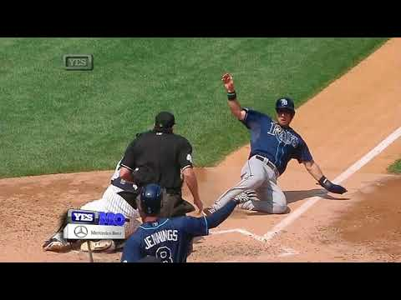
Training
Working the “wedge”
Respecting the Game since 1921
Notes:
12

Slide 13
Training
Working the “wedge”
Play at the plate
Respecting the Game since 1921
Notes:
13

Slide 14
Post Meeting Items:
Mentor Connection
Dues Questions
New Members
Respecting the Game since 1921
Notes:
14

Slide 15
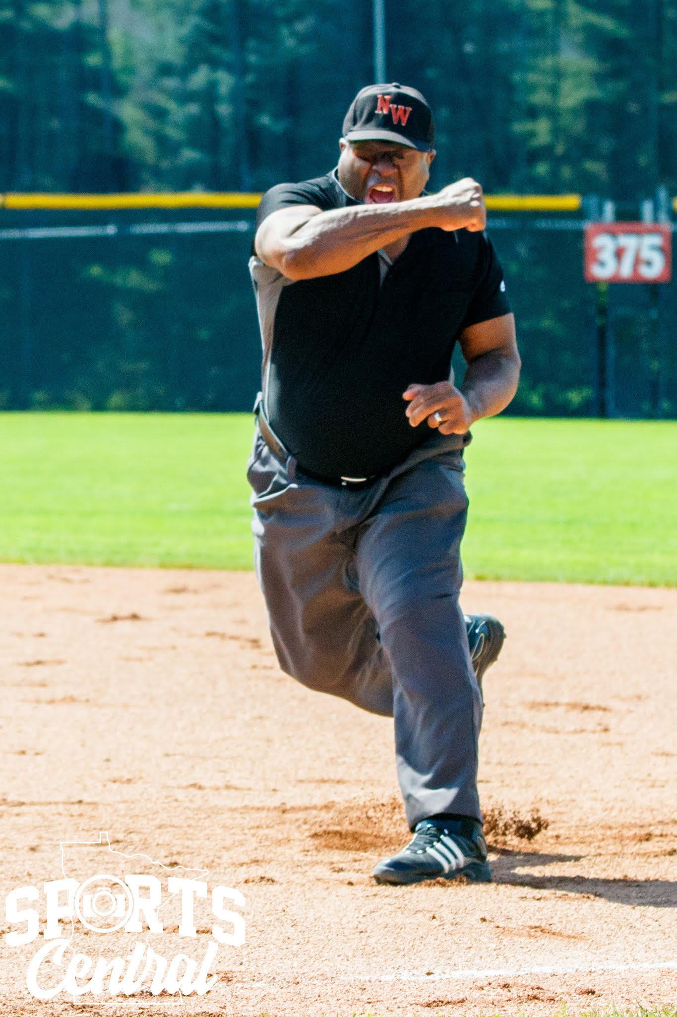
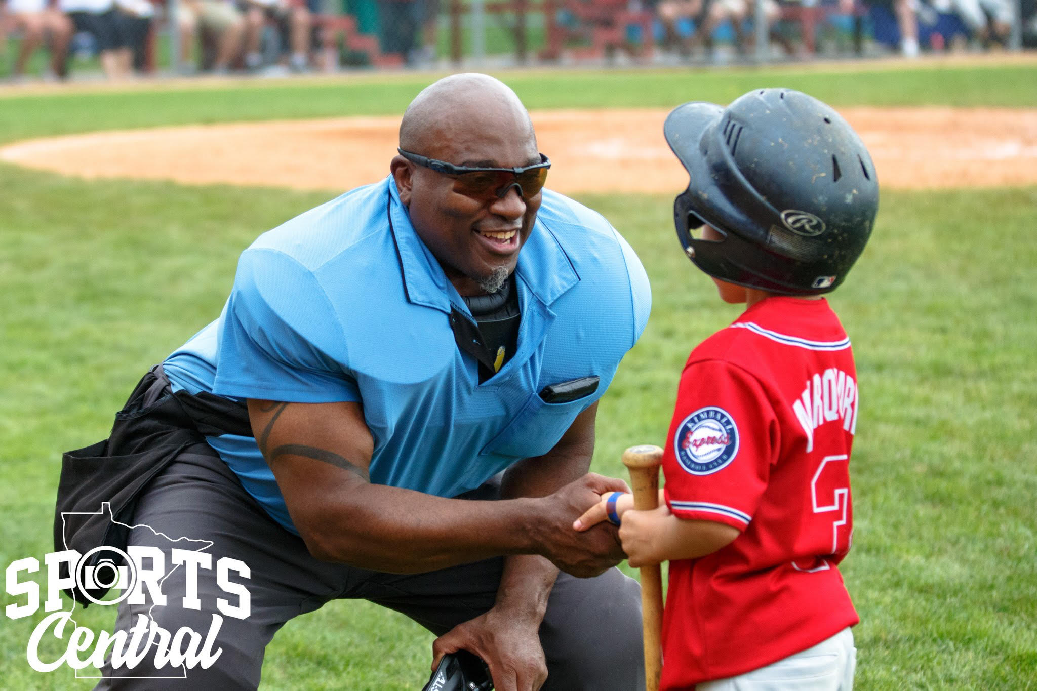
In Memory Of
Eleazar (Zar) Kovalov
Respecting the Game since 1921
Notes:
15

